Slide 1
Shell Bootcamp 2024 3 Reflections for Week #2
Achal Shankar Gupta
Date : 06-Sep-2024

Slide 2

About Me
“I am not afraid of storms for I am learning how to sail my ship.”

Slide 3

My learnings from this week!

Slide 4
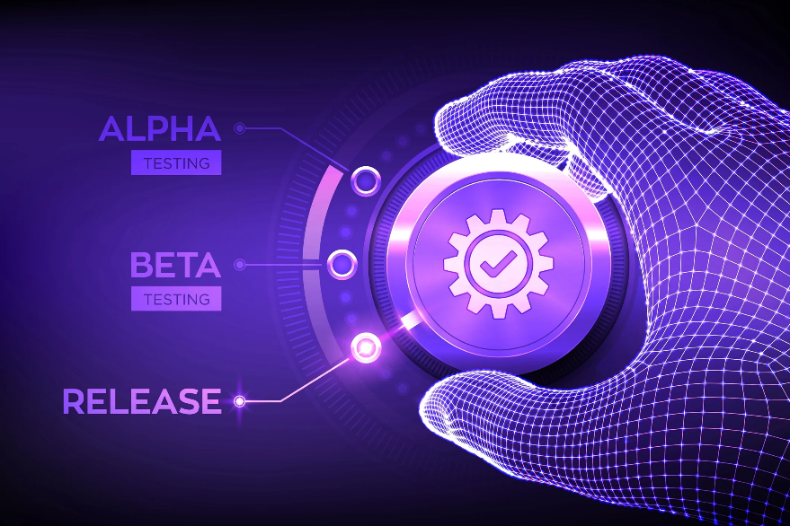
Learning 1 | My takeaways
Software Testing Life Cycle (STLC), its deliverables, the differences between SDLC and STLC, the Testing Triangle, types of testing, automated vs manual testing.
Understanding the role of STLC in the overall development process and knowing when to use automated vs manual testing are essential for ensuring software reliability and efficiency.
In the energy sector, software is crucial for managing complex systems and operations. Proper implementation of STLC and automated testing ensures that the software Shell relies on is robust, accurate, and efficient, reducing risks and improving the performance of critical systems used in energy production and management.

Slide 5
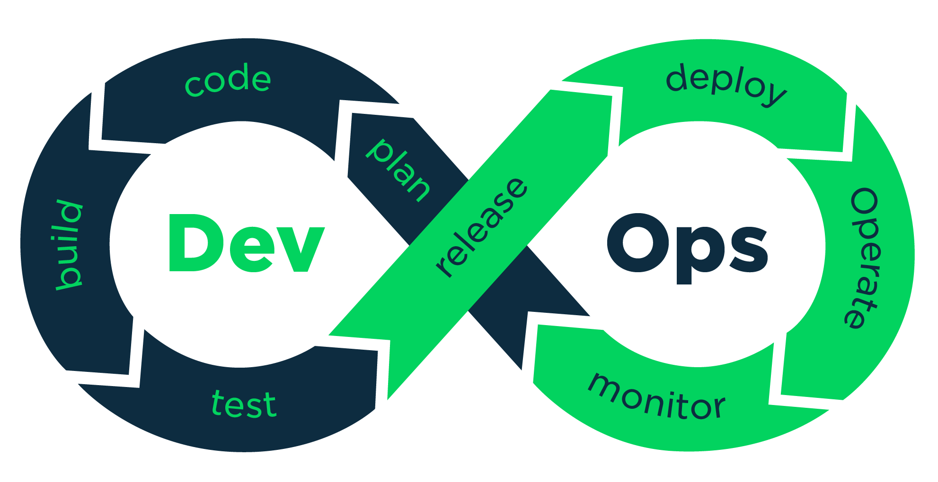
Learning 2 | My takeaways
I explored DevOps, covering the software development environments, DevOps lifecycle, principles, and tools, importance of Continuous Integration (CI) and Continuous Deployment (CD), GitHub Actions and its components, and insights into the structure of a YAML file.
DevOps fosters collaboration between development and operations teams, streamlining software delivery through CI/CD practices. Learning GitHub Actions and YAML file components enhances the automation and management of these processes.
In the energy sector, DevOps practices help Shell streamline its software development and deployment processes.

Slide 6
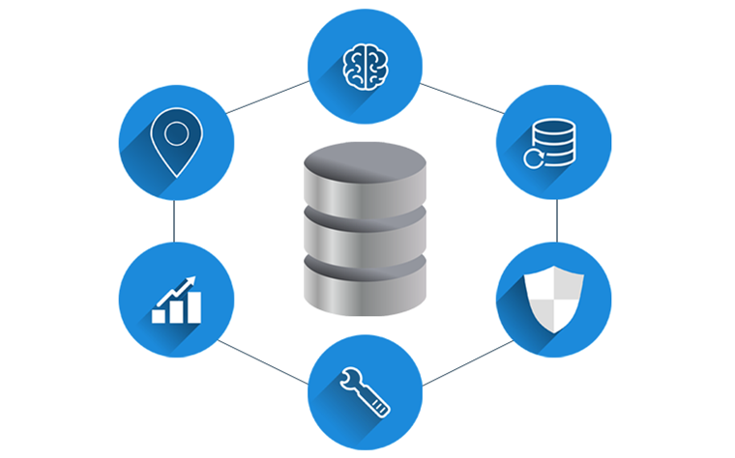
Learning 3 | My takeaways
I got to learn about DBMS, different types of databases, explored SQL operations, joins, normalization, as well as cloud computing concepts, including service and deployment models, Azure services, Virtual Machines, and Azure DevOps.
Understanding how to manage data through DBMS and using cloud services like Azure is essential for optimizing data handling and supporting scalable, cloud-based solutions.
Efficient data management can be applied at Shell, where managing large amounts of data and using cloud platforms like Azure ensures reliable, scalable, and secure operations, supporting vital energy infrastructure.

Slide 7

Relevance of learnings for my organization

Slide 8

Learning 1 | Relevance for Shell
Shell likely incorporates Software Testing Life Cycle (STLC) practices to ensure that its software systems, which support various operations, are rigorously tested. By using both automated and manual testing methods, Shell can maintain the reliability and functionality of critical software across its platforms.

Slide 9
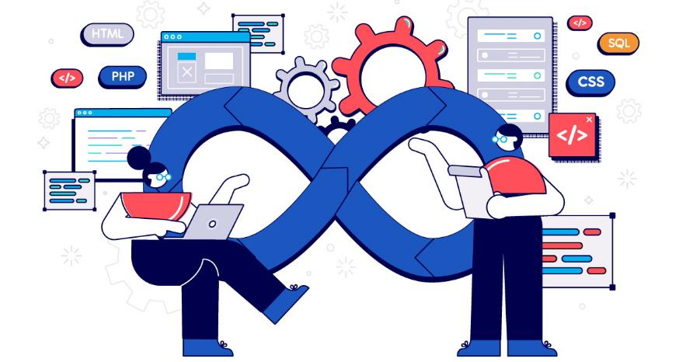
Learning 2 | Relevance for Shell
Shell likely implements DevOps principles by integrating development and operations teams, using tools like GitHub Actions to automate workflows and establish CI/CD pipelines. This approach ensures smoother, faster, and more reliable software development and deployment across various projects.

Slide 10

Learning 3 | Relevance for Shell
Shell likely implements DBMS and cloud solutions by utilizing databases like PostgreSQL and cloud platforms such as Azure. These tools help manage large datasets, ensure data security, and enable smooth deployment of applications through services like Azure DevOps.

Slide 11

Challenges in implementing learning

Slide 12

Challenge faced while implementing Learning 1
After designing my own test cases for the case study and reviewing others’ work, I realized I overlooked some fundamental scenarios that should have been tested. Moving forward, I aim to sharpen my ability to identify these critical test cases more effectively.

Slide 13

Challenge faced while implementing Learning 2
While working with GitHub Actions and YAML files, I noticed that I struggled to fully understand how to create automated workflows. I need to enhance my understanding of automation tools to improve efficiency in future projects.

Slide 14
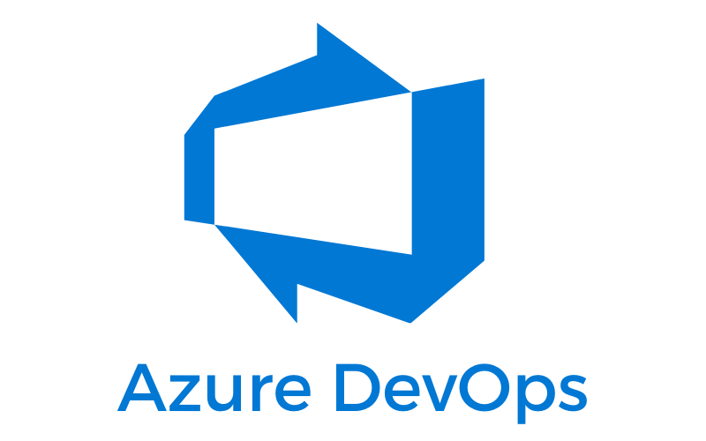
Challenge faced while implementing Learning 3
While working with Azure DevOps, I realized that I had some difficulty in understanding the various work items that the service provides. I need to focus on mastering the finer aspects of Azure DevOps.

Slide 15

Action Plan

Slide 16
My Action Plan for this Week
Actions
Timeline
Status
From now on I aim to get more hands on experience of the tools that I struggle with.
Start immediately and aim to get hands on with Github actions and Azure DevOps.
By the end of this week, I have successfully implemented an automated workflow on Github actions and created a Sprint on Azure DevOps.

Slide 17

Learning is also Fun!

Slide 18
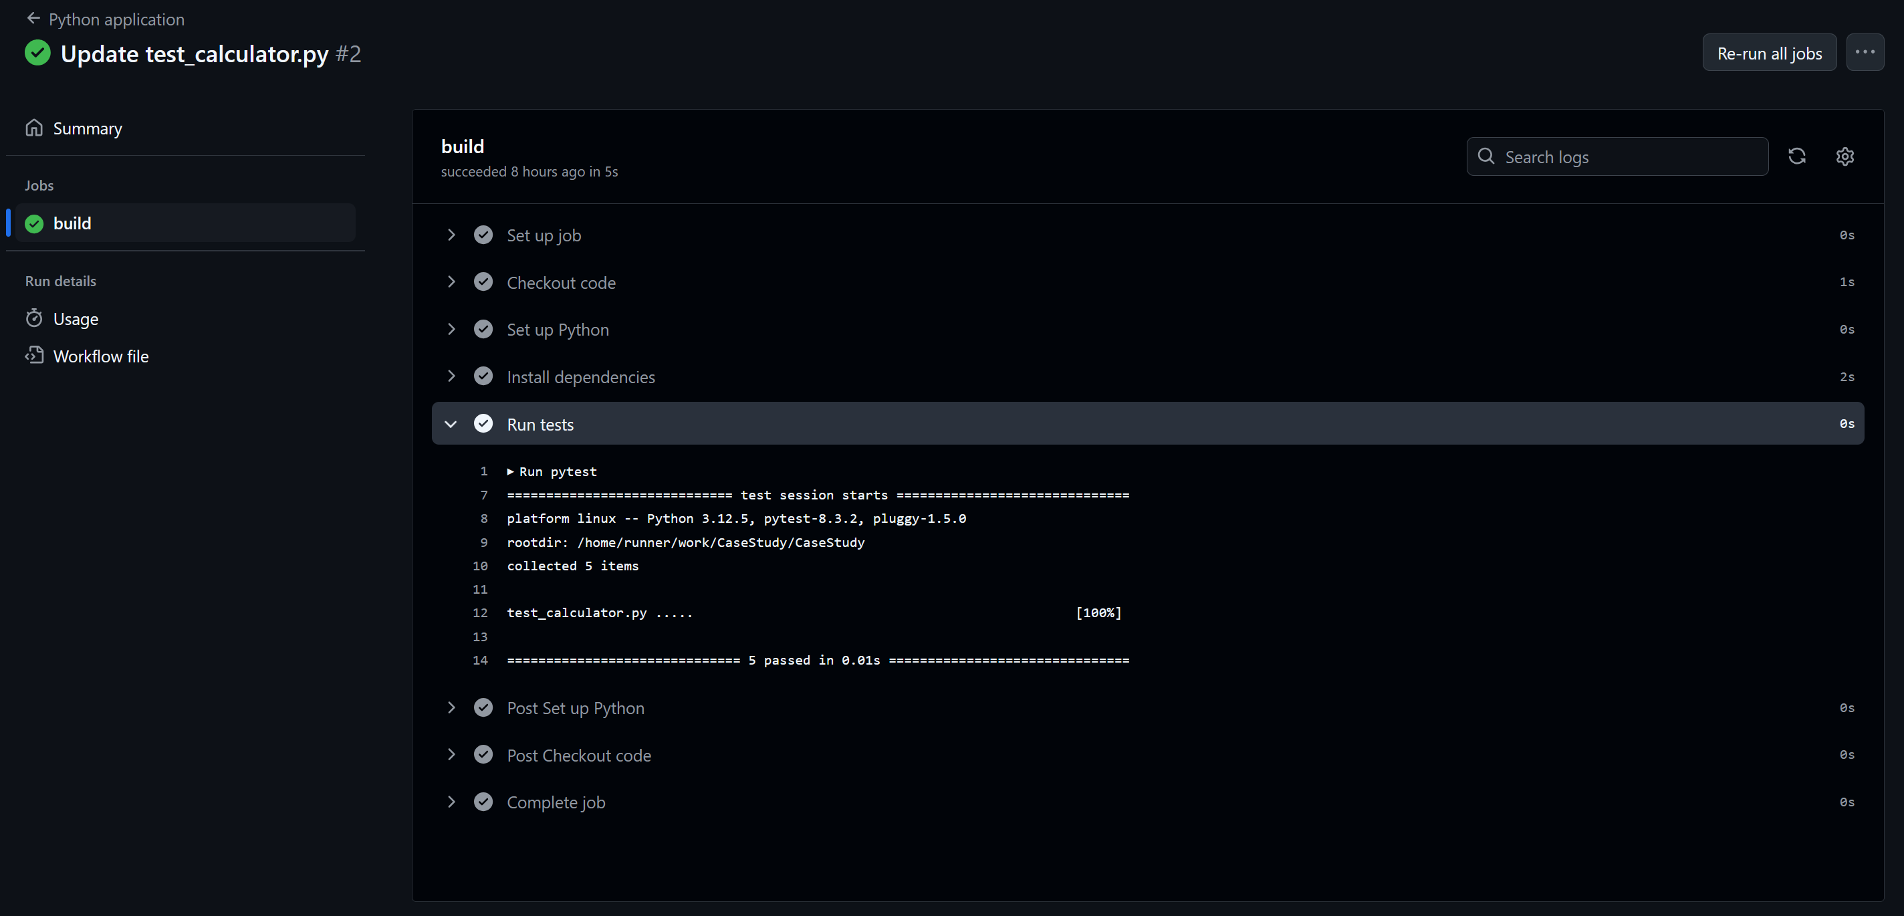
Learning is also Fun!
The case study that we did on the final day of the week was really fun, especially creating a CI/CD pipeline on Github actions. I was able to better understand each component of this tool, and was able to create a successful build in one go.

Slide 19

Summary
This week focused on developing core technical skills such as DBMS and Cloud with important techniques such as Software Testing and DevOps.
The upcoming week will dive into the custom bootcamp for my department.
The DevOps principles and the cloud technologies will definitely help in understanding the upcoming sessions better as they will have a base in these topics.

Slide 20
Thank You

